Slide 1

Uncertainty-Quantified, Deferral-Aware AI Triage for Screening Mammography with MASAI-Inspired Endpoints
Project Report [Phase-I] | B.Tech, Computer Science and Engineering
Indian Institute of Information Technology, Bhopal (M.P.)
Manav Pratap Singh 24U022028
Under the supervision of Dr. Ridhi Arora and Dr. Yatendra Sahu,
Assistant Professor (CSE)
November 2026

Slide 2
Uncertainty-Quantified, Deferral-Aware AI Triage for Screening Mammography with MASAI-Inspired Endpoints
Introduction
Context: Population breast-cancer screening depends on double reading by radiologists, which is slow and costly at national scale.
Opportunity: AI can triage exams and reduce reading load. The MASAI randomised trial (≈100,000 participants) uses an AI score to set reading intensity, with interval cancer as the principal endpoint.
Limitation of today's tools: deployed systems are fixed, commercial and score-only. They give no calibrated uncertainty and cannot learn when to abstain.
Our idea: an open pipeline that estimates how sure it is about each exam and hands uncertain exams to human readers, under a strict safety constraint (sensitivity ≥ 0.95).

Slide 3
Literature Review
Prospective trials of fixed AI
Retrospective triage and deferral
Uncertainty quantification
MASAI: ≈100,000 participants; score-10 exams double-read, rest single-read; interval cancer is the principal endpoint.
PRAIM: 463,094 women; detection 6.7 vs 5.7 per 1,000 (+17.6%) with non-inferior recall.
AI-STREAM: 24,543 women; detection +13.8% at unchanged recall.
ScreenTrustCAD: radiologists over-trust AI flags (PPV 22% vs 3.4%).
Danish simulation: workload −62.6% with non-inferior sensitivity.
Córdoba (DBT): workload −72.5%, sensitivity non-inferior.
CoDoC (UK): learned deferral gives −66% workload and 25% fewer false positives.
Finnish triage: skipping low-score exams cuts recall but can miss cancers.
MC-dropout and deep ensembles are the most used UQ methods in medical image classification.
Both are easy additions to existing models and behave well on out-of-distribution data.
A 5-member ensemble is enough for robustness to dataset shift.
RSNA challenge: top-10 ensemble reached 67.8% sensitivity vs 27.6% median single algorithm.

Slide 4
Literature Review: Comparison and Research Gap
Study | Approach | Key result | What is missing
MASAI | RCT; AI score sets reading intensity | ≈100,000 women; interval cancer as primary endpoint | Fixed commercial tool; score-10 rule only; no uncertainty
PRAIM | Real-world AI-supported double reading | Detection +17.6%; recall non-inferior | Closed tool; no calibration or learned abstention
Danish triage | Low scores unread, high scores recalled | Workload −62.6%; sensitivity 69.7% vs 70.8% | Fixed threshold; no abstention
CoDoC | Learned deferral between AI and clinician | Workload −66%; 25% fewer false positives | No explicit sensitivity floor; no aleatoric/epistemic split
RSNA ensembles | Ensembling submitted algorithms | 60.7% (top-3), 67.8% (top-10) vs 27.6% median | No abstention signal
Research gap: no prior system combines an open and reproducible algorithm, calibrated probabilities, separated aleatoric/epistemic uncertainty, a learned abstention policy, an enforced sensitivity floor and a missed-cancer proxy. RP3 targets this combination.

Slide 5
Problem Statement
Problem
Formal objective
Maximise workload reduction subject to a hard sensitivity floor of 0.95, evaluated on MASAI-style endpoints (recall rate, cancer detection rate, workload) plus calibration (ECE) and a missed-cancer proxy.
Double reading in screening mammography is costly. Fixed AI triage tools reduce workload but output only a score: they cannot express how confident they are, do not abstain on hard exams, and offer no calibrated basis for a safety guarantee. Skipping the wrong exams means missed cancers.
Required outputs for each exam
Triage label: fast-track normal / routine double-read / recall.
Deferral decision: act autonomously or send to human arbitration.
Confidence: a per-exam score that drives both decisions.

Slide 6
Methodology
Input exam
Paired CC/MLO views, 512×512
Deep ensemble
5 CNNs × 10 MC-dropout samples
Uncertainty
μ, σ²ale, σ²epi, ψ; u = σ²epi + λψ
Calibration
Platt / isotonic; target ECE < 0.05
Deferral policy
Thresholds τ0, τ1, υhigh
→
→
→
→
Decision rule (per exam)
How thresholds are learned
If u > υhigh: abstain and send to human arbitration.
Else if μ > τ1: recall (human read).
Else if μ > τ0: routine double-read.
Otherwise: fast-track normal, no human read.
Maximise specificity subject to sensitivity ≥ 0.95 and arbitration rate ≤ ρmax, on the calibration set.
Bounded threshold search using Optuna.
Policy is trained on frozen ensemble outputs, so it works with any locked or upgraded model.
Optional CoDoC-style layer defers only where a human is expected to add value.

Slide 7
Implementation Details
Datasets and their roles
Training and deployment
Dataset | Role in pipeline
RSNA screening cohort | Train / calibrate / test; MASAI-style endpoints
CBIS-DDSM (10,239 images) | Lesion-level auxiliary supervision; film-domain shift
CMMD (3,728 images, 1,775 patients) | External check; site-shift simulation
WDBC (569 samples) | Sanity check of threshold machinery
OPTIMAM (3.07 M images) | Long follow-up for interval cancers; flagged as limitation
Preprocessing: windowing, centre-crop, resize 512×512, z-score per view; no ROI cropping at inference.
Splits: patient-level, stratified by cancer label and density.
Training: cross-entropy, augmentation, early stopping on validation AUC; auxiliary lesion and density heads.
Stack: PyTorch, ONNX int8, Optuna, netcal, statsmodels.
Compute: ≈0.2 s/exam, CPU only, < 8 GB memory.
Phase A: Development
Train on RSNA, calibrate, fit thresholds
Phase B: Validation
External checks on CBIS-DDSM and CMMD
Phase C: Simulation
MASAI-style protocol replay; workload–safety curves

Slide 8
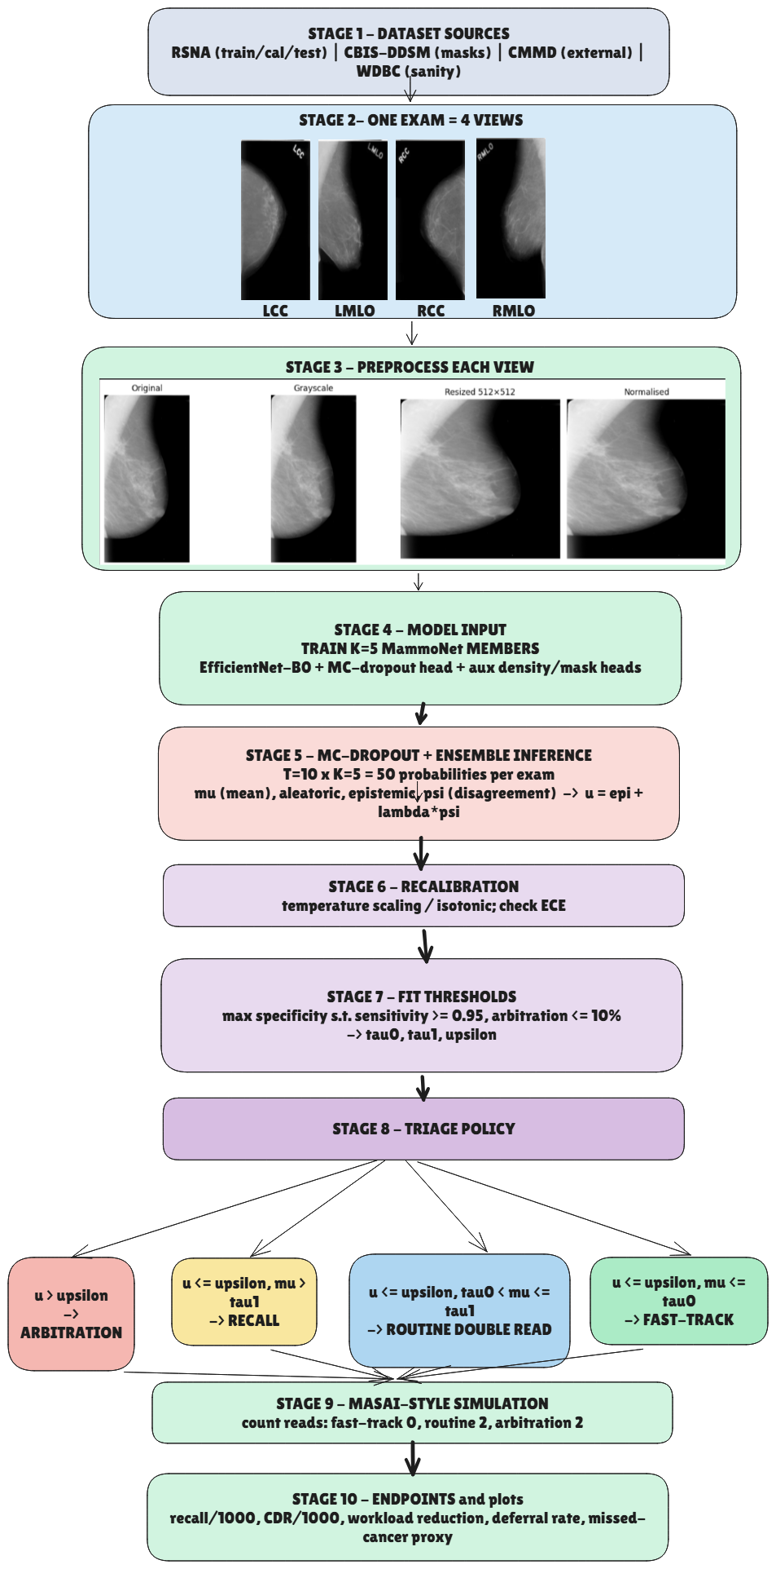
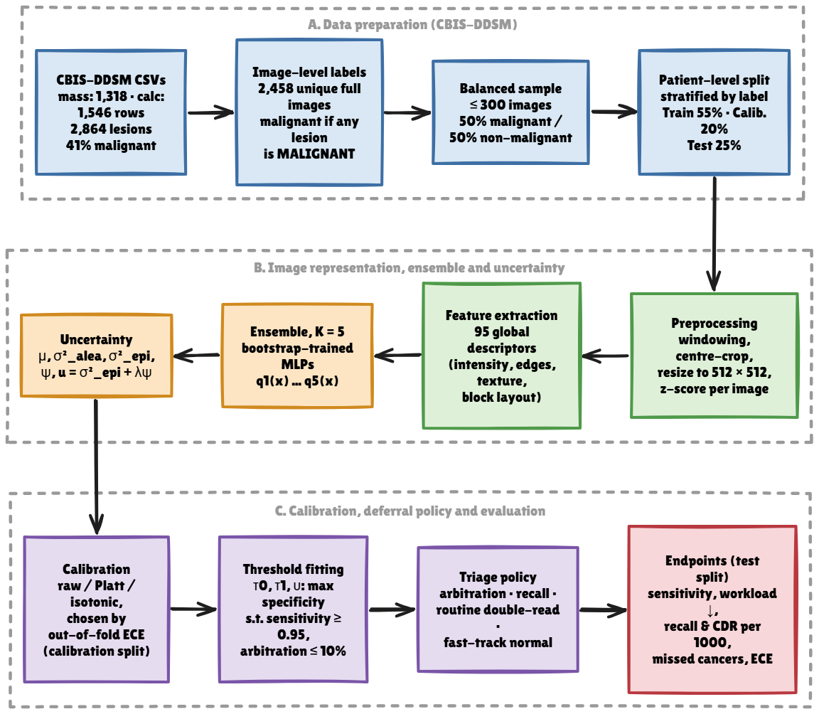

Slide 9
Results: Design Targets and Benchmark Context
Metric | Target | Basis
Workload reduction | ≥ 30% at sensitivity ≥ 0.95 | Published: 45–63% fixed triage, ≈67% learned deferral
Calibration | ECE < 0.05 | Calibrated outputs are a precondition for expert trust
Abstention | Rises with poor image quality or domain shift | Epistemic uncertainty should flag out-of-distribution exams
Missed-cancer proxy | Reported as a rate, never hidden | Safety is the acceptance criterion for autonomous triage
Resources | ≈0.2 s/exam; < 8 GB; CPU only | Enables low-cost deployment

Slide 10
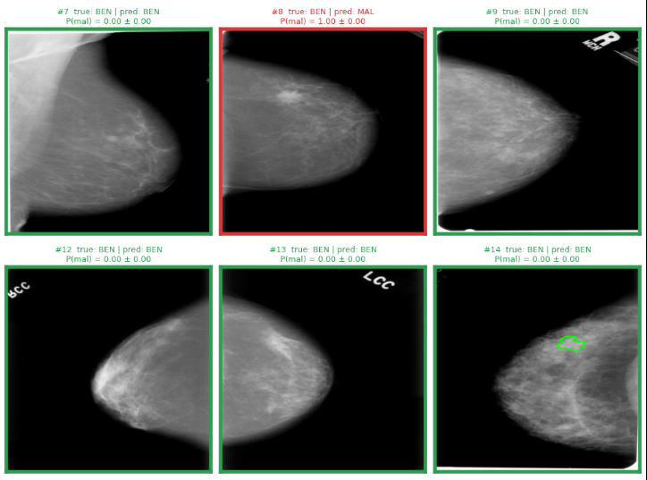
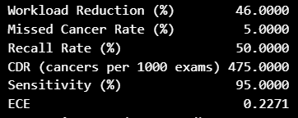
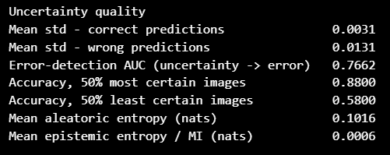
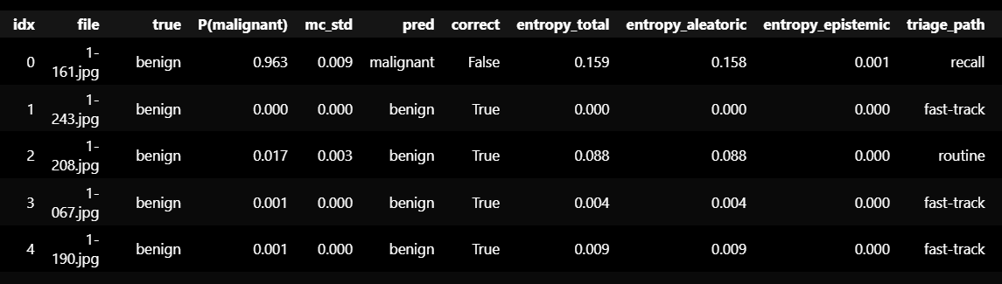

Slide 11
Conclusion and Future Scope
Conclusion
Future scope
Triage is framed as selective prediction with structured deferral.
Ensemble + MC-dropout separates aleatoric from epistemic uncertainty; calibration targets ECE < 0.05.
Thresholds are learned to maximise specificity under sensitivity ≥ 0.95.
The ≥ 30% workload target is conservative against published 45–72% reductions.
The pipeline is open, reproducible and runs on a CPU workstation.
Long-follow-up data (OPTIMAM, EMBED) to measure true interval cancers.
Real-reader studies to replace reader proxies.
Extension to digital breast tomosynthesis (DBT).
Study of human–AI interaction and over-trust of AI flags.
Prospective MASAI/PRAIM-style evaluation with a frozen, locked policy for regulatory review.

